Slide 1
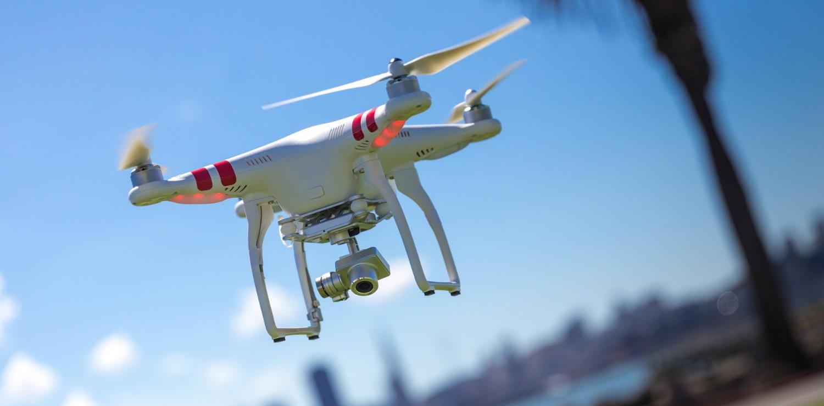
NextDrone Technology:
Temporary Traffic Light Drone
ME 2212- Intro to ME Design
Speaker: Daniel Segrest
Team 6: Lucy Guo, Skylar Ned, Harley Nguyen, Daniel Segrest, Barrett Serio, Luke Williams
http://www.thepplgroup.com/wp-content/uploads/2015/08/maxresdefault.jpg
Notes:
Good afternoon, my name is Daniel Segrest from Team 6, and our team was tasked with generating a new concept for drone technology. And the final design that we went with was a drone which functions as or in conjunction with a portable traffic light system. More on that to come.

Slide 2
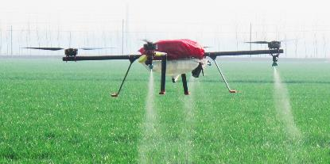
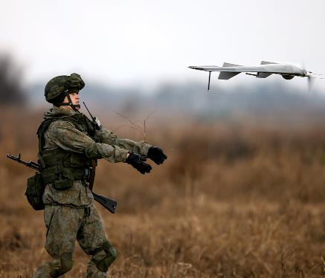
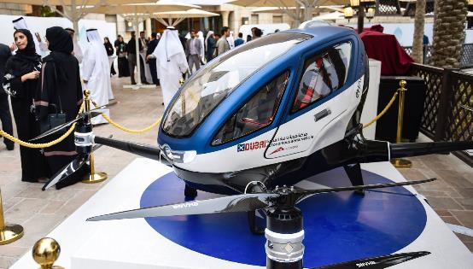
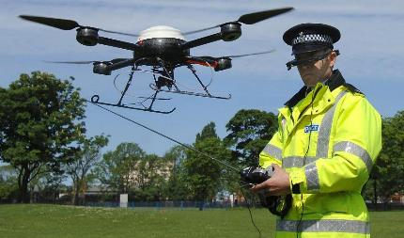
Current applications of Drones
Introduction
Design Synthesis
Manufacturing/Testing/Safety
Engineering
Specifications
Conclusions
http://static3.businessinsider.com/image/598b5e4b76084a26008b760c-2400/drns.jpg
Agriculture
https://www.dubai.com/media/uploads/dubai.com/2017/02/EHang184.jpeg
https://cdni.rbth.com/rbthmedia/images/all/2016/11/21/drone_rtx2sbua_b.jpg
Taxi Drone
Military
https://dronelife.com/wp-content/uploads/2016/02/policeBritishdrone.jpg
Speaker: Daniel Segrest
Surveillance
Notes:
Unmanned aerial vehicles, UAV’s, or drones. have been around for a few decades now with the initial interest being in military applications, but with the advent of better battery technologies and utilization of brushless motors, drones have miniaturized and dropped significantly in price. New applications for drones are being conceived all the time. Agricultural applications include precise irrigation or pesticide usage. Aerial drones with multispectral viewing can be used to detect leaking landmine chemicals. And in Dubai, Ehang has begun test flights of a single passenger, 8 rotor drone taxi this year.

Slide 3
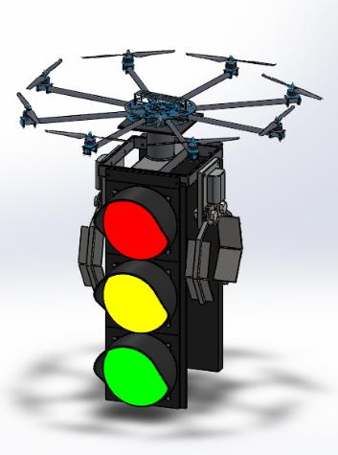
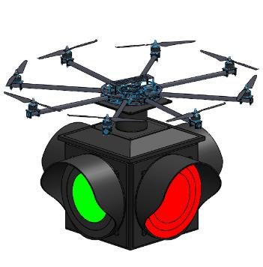
Objective
Introduction
Design Synthesis
Manufacturing/Testing/Safety
Engineering
Specifications
Conclusions
Determine feasibility of new process/application for drone technology
Proposed Solution
Temporary Traffic Light Drone
Figure 1: Solidworks Model of Temporary Traffic Light Drone
Speaker: Daniel Segrest
Notes:
Objectives, Solution, statistics about temporary traffic lights to justify choice

Slide 4
General Workflow Overview
Introduction
Design Synthesis
Manufacturing/Testing/Safety
Engineering
Specifications
Conclusions
Decision Matrix
Subject
Function
Engineering Specs.
Cleaning, Weather, Detection, Maintenance, Traffic, Guide Tool, Companion
Temporary Traffic light, Road Hazard Detection, Traffic Flow Monitoring, Debris Removal, Car Communicator, Police Escort
Drone Selection
Traffic Drone Design
Speaker: Daniel Segrest
Notes:
How we broke down the problem. Used Decision Matrices Subject: Area in need of Drone Technology, Function: Specific Function of Drone. Next did HOQ to understand problem with traffic., Then Proposed Drone designs and modeled and so on.

Slide 5
General Workflow Overview
Design Synthesis
Manufacturing/Testing/Safety
Engineering
Specifications
Conclusions
Introduction
Decision Matrix
Solidworks Models
Testing/Safety/Manufacturing Procedures
Conclusions
Speaker: Daniel Segrest
Notes:
How we broke down the problem. Used Decision Matrices Subject: Area in need of Drone Technology, Function: Specific Function of Drone. Next did HOQ to understand problem with traffic., Then Proposed Drone designs and modeled and so on.

Slide 6
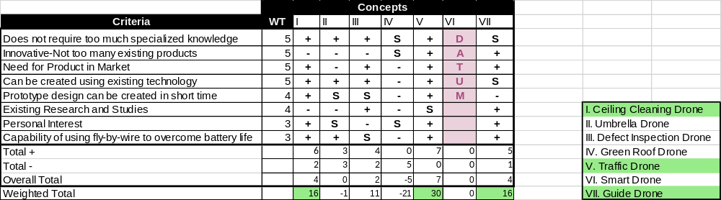
Decision Matrix 1: Subject
Introduction
Design Synthesis
Manufacturing/Testing/Safety
Engineering
Specifications
Conclusions
Speaker: Daniel Segrest
Notes:
Ideas: we brainstormed many ideas, researched each, and eliminated any that were obviously not possible. We set criteria for our narrowed down concepts and determined a traffic related drone was the most feasible. Ceiling cleaning drone and guide drone were good alternatives.

Slide 7
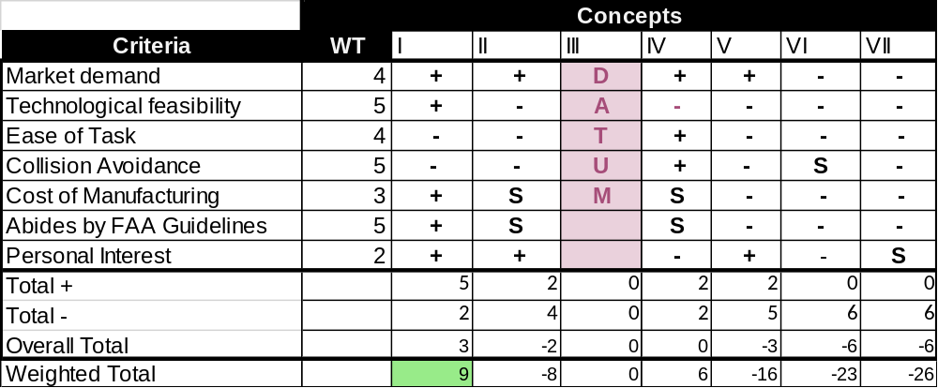
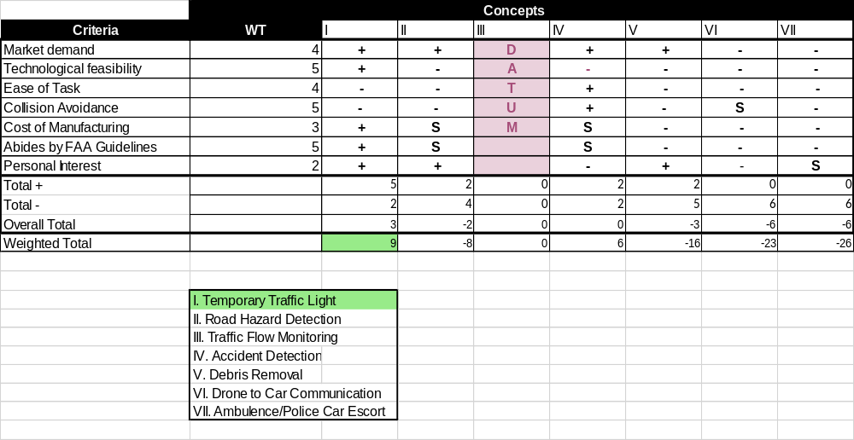
Decision Matrix 2: Function
Introduction
Design Synthesis
Manufacturing/Testing/Safety
Engineering
Specifications
Conclusions
Speaker: Daniel Segrest
Notes:
Ideas: we brainstormed many ideas, researched each, and eliminated any that were obviously not possible. We set criteria for our narrowed down concepts and determined a traffic related drone was the most feasible. Ceiling cleaning drone and guide drone were good alternatives.

Slide 8
Primary and Secondary Customers
Design Synthesis
Manufacturing/ Testing/Safety
Conclusions
Engineering
Specifications
Introduction
Department of Transportation and Development (DOTD)
Traffic Maintenance Responders
Construction Companies
Primary
North American Public Market
Event Coordinators
Secondary
Global Market
Tertiary
Speaker: Skylar Ned

Slide 9
Customer Analysis and Requirements
Design Synthesis
Manufacturing/ Testing/Safety
Conclusions
Engineering
Specifications
Introduction
Key Facts
  311,000 signals in the United States in 2011
  New traffic signal installation Cost: $250,000-$500,000
  Yearly Electric bills and routine maintenance: $8,000 a year per light
  For Maintenance: many Traffic Agencies lack adequate staff: forced to address only the most critical issues
Resulting Requirements
  Serve as a temporary Traffic Light
  Fast and easy deployment
  Safe while active
  Reasonable Cost
Speaker: Skylar Ned
Notes:
2012 National Traffic Signal
Report Card score is a 69, equivalent to a D+ letter grade

Slide 10
Design Constraints
Design Synthesis
Manufacturing/ Testing/Safety
Conclusions
Engineering
Specifications
Introduction
Use Existing Drone Technology
Modular- easily adapted to two or more drone providers
Adhere to FAA Guidelines
Drone must be able to hold 10-20 kg payload of Traffic light
Develop cost under $20,000
Speaker: Skylar Ned

Slide 11
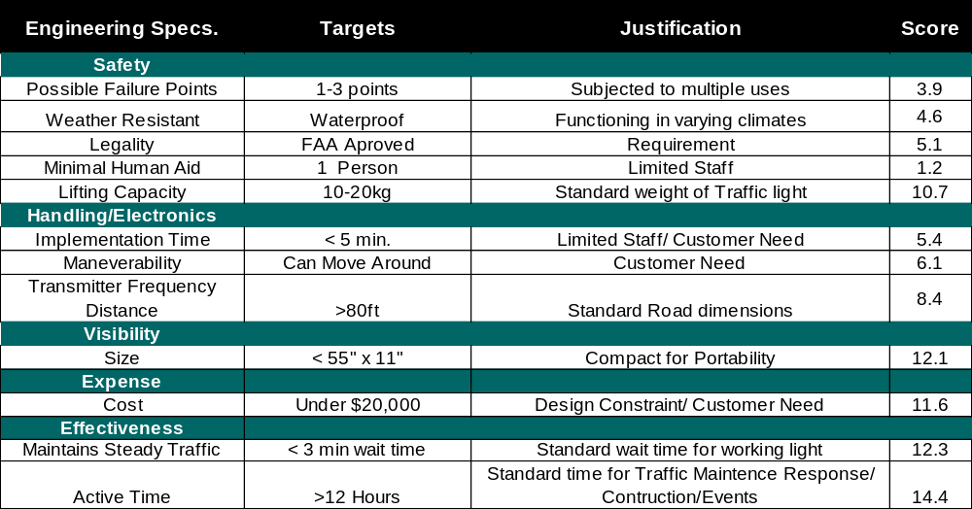
HOQ Metrics for Performance Evaluation
Design Synthesis
Manufacturing/ Testing/Safety
Conclusions
Engineering
Specifications
Introduction
Speaker: Skylar Ned

Slide 12
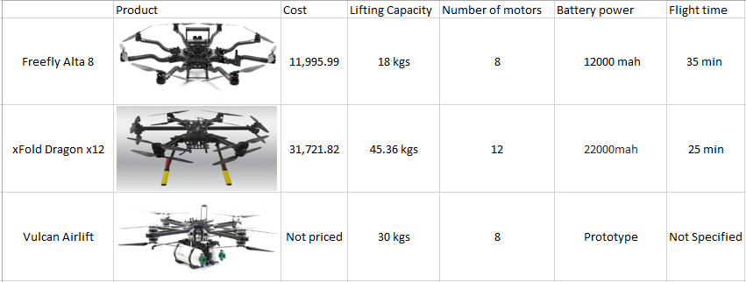
Drone Selection
Engineering
Specifications
Manufacturing/ Testing/Safety
Conclusions
Design Synthesis
Introduction
Speaker: Barrett Serio
Notes:
Minimize work by purchasing Drone. Selection choice limited by lifting capacity. Standard traffic lights vary in weight from 10-20kg

Slide 13
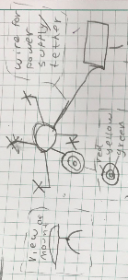
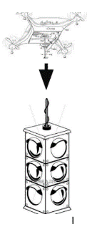
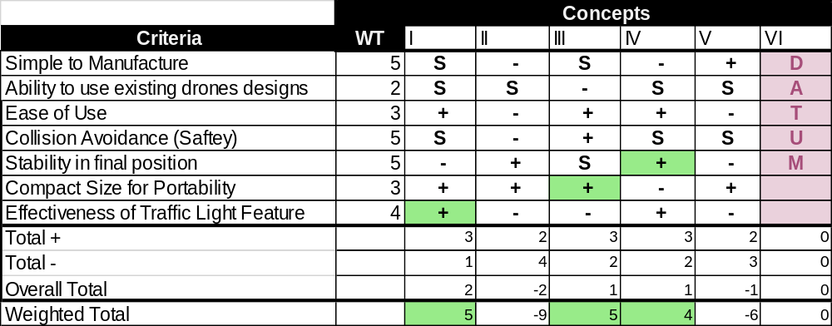
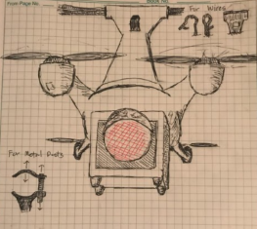
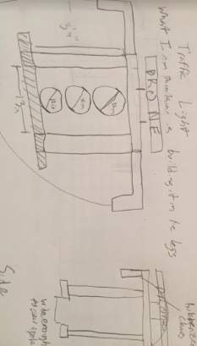
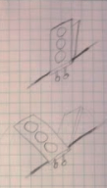
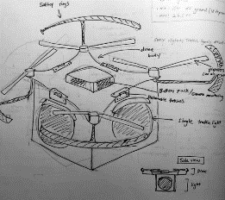
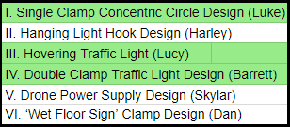
Decision Matrix 3: Drone Design
Engineering
Specifications
Manufacturing/ Testing/Safety
Conclusions
Design Synthesis
Introduction
V
I
II
VI
III
IV
Speaker: Barrett Serio

Slide 14
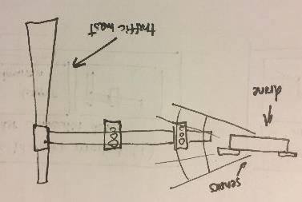
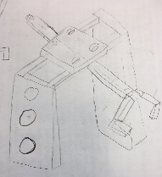
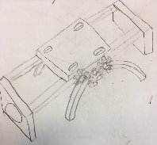
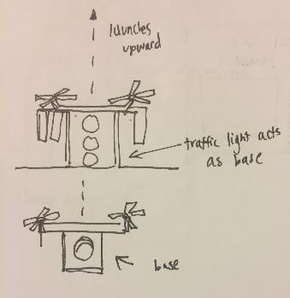
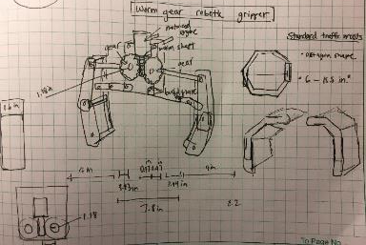
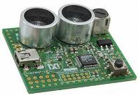
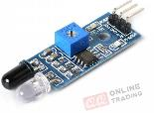
Functional Decomposition and Refined Concepts
Engineering
Specifications
Manufacturing/ Testing/Safety
Conclusions
Design Synthesis
Introduction
Detects Traffic Mast
Attaches to Mast
Optical, Infrared, Ultrasonic Sensors
Clamp designs
Drone Launches
Mast Scenario
https://www.digikey.com.au/-/media/Images/Article%20Library/TechZone%20Articles/2016/March/Sensor-
http://qqtrading.com.my/image/cache/catalog/Products/Module/Infrared-IR/TE174-04-700x700-product_popup.jpg
Speaker: Barrett Serio
Notes:
Minimize work by purchasing Drone. Selection choice limited by lifting capacity. Standard traffic lights vary in weight from 10-20kg

Slide 15
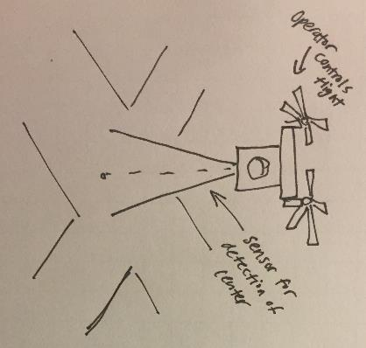
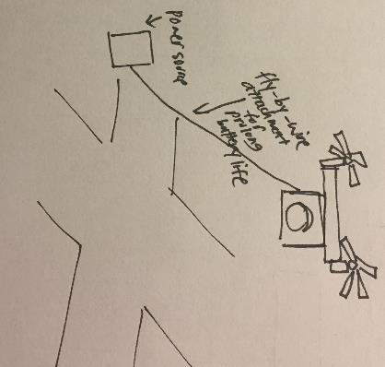
Hover Scenario
Flies to center of intersection
Stabilizes and Hovers Above
Incorporation of Fly-By-Wire
Speaker: Barrett Serio
Notes:
Minimize work by purchasing Drone. Selection choice limited by lifting capacity. Standard traffic lights vary in weight from 10-20kg

Slide 16
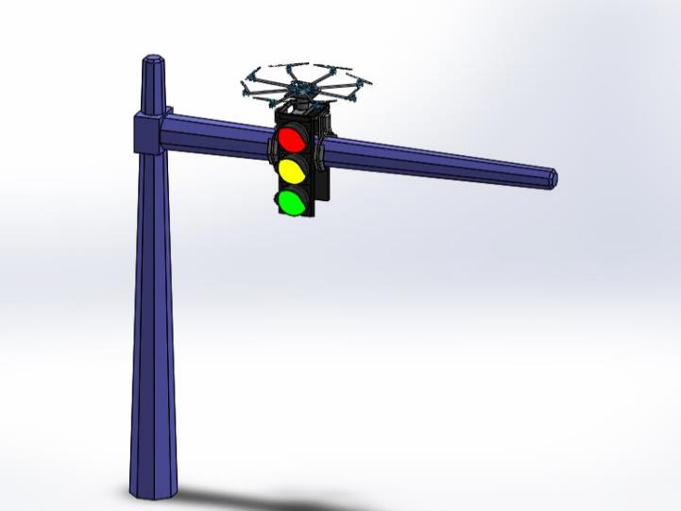
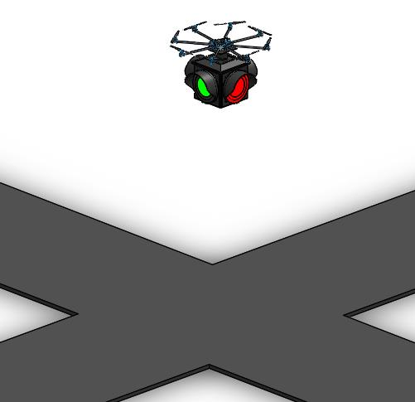
Solidworks Models: Overview
Engineering
Specifications
Manufacturing/ Testing/Safety
Conclusions
Design Synthesis
Introduction
Mast Attachment
Hovering
Speaker: Lucy Guo

Slide 17
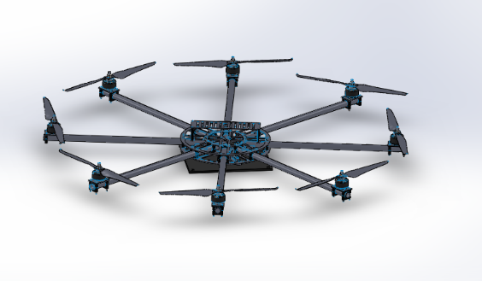
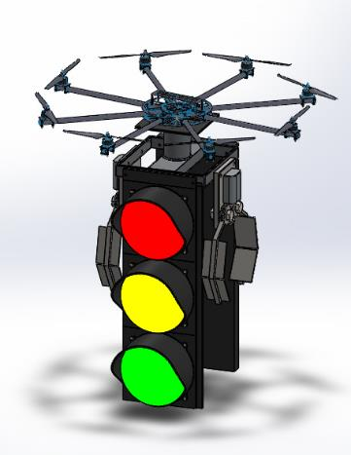
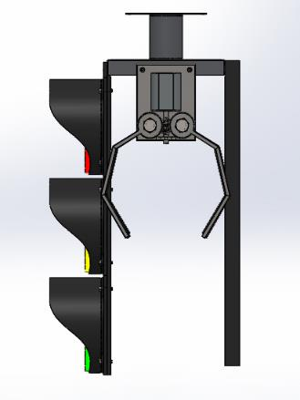
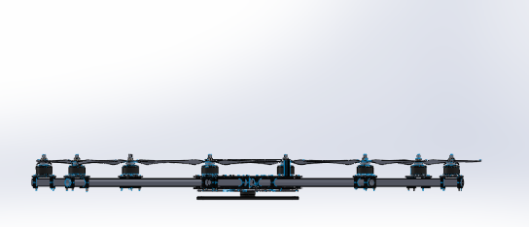
Solidworks Models: Mast
Engineering
Specifications
Manufacturing/ Testing/Safety
Conclusions
Design Synthesis
Introduction
FreeFly Alta 8
Connection Plate
Clamp
https://grabcad.com/library/octocopter-with-3-axis-camera-mount/details?folder_id=226502
LED Lights
Battery Pack/Counter Balance
Connection Plate
Figure 2: Dimetric and Side Views: Traffic Light Mast Attachment
Figure 3: Dimetric and Side View of Drone
Speaker: Lucy Guo

Slide 18
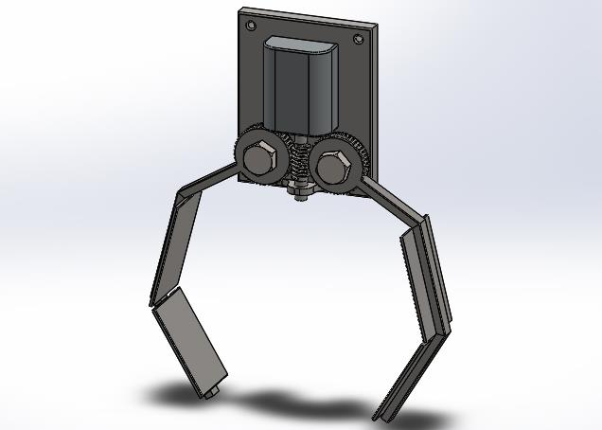
Solidworks Models: Mast
Engineering
Specifications
Manufacturing/ Testing/Safety
Conclusions
Design Synthesis
Introduction
Electric Engine
Worm Screw
Clamping Plates
Worm Gears
Figure 4: Parts of Clamp Design
Figure 5: Clamp Animation
Speaker: Lucy Guo

Slide 19
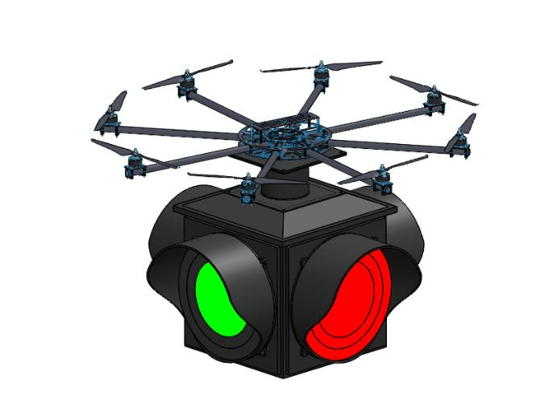
Solidworks Models: Hover
Engineering
Specifications
Manufacturing/ Testing/Safety
Conclusions
Design Synthesis
Introduction
Connection Plate
4-way Single Light
Figure 6: Hovering Traffic Light Mast Attachment
Figure 7: Light Animation
Speaker: Lucy Guo

Slide 20
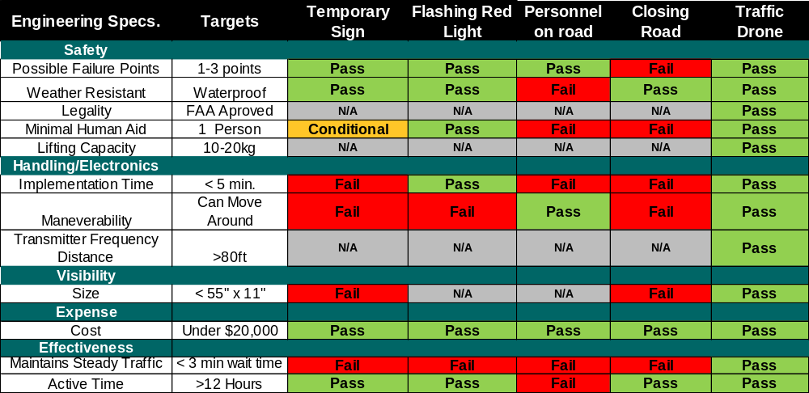
Design Specification Comparssion to Competitors
Engineering
Specifications
Manufacturing/ Testing/Safety
Conclusions
Design Synthesis
Introduction
Speaker: Luke Williams

Slide 21
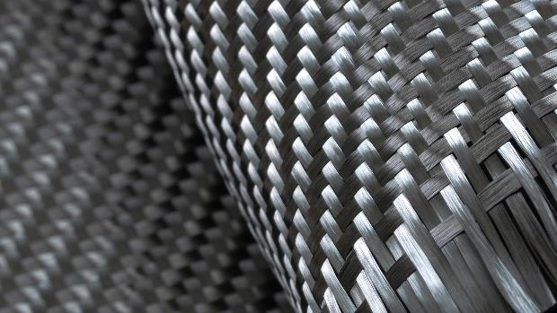
Materials
Engineering
Specifications
Design Synthesis
Conclusions
Manufacturing/ Testing/Safety
Introduction
  FreeFly Alta 8 Drone
    Carbon Fiber
    Aluminum
  Traffic Signal Attachments
    Polycarbonate
      thermoplastic
Image source: http://carbonfiberstuff.com/
Speaker: Luke Williams
Notes:
Image source: http://carbonfiberstuff.com/
The most important qualities for the materials in this drone design is for them to be lightweight.
The drone is made from carbon fiber and aluminum (though we did not get to pick these they are very light)
Signal made from polycarbonate, lightweight thermoplastic, trafic signals typically made from this

Slide 22


Manufacturing/ Maintenance
Engineering
Specifications
Design Synthesis
Conclusions
Manufacturing/ Testing/Safety
Introduction
1. Two Traffic Light Attachments
    Mast Assembly
    Hover Assembly
    3 Light System and Frame
    Worm Gear Clamp
    Single 4-way Light and Frame
2. Modify Drone
  Add Attachment Plate
Connection Plate
Speaker: Luke Williams
Notes:
Biggest portion for us to manufacture would be the traffic signal portion. Only need to modify drone to attach to traffic signal.
Multiple attachments depending on if hover function wanted or land/ attach function wanted. Maintaining the drone is easy. If blades are broken or damaged can easily be replaced, available from drone manufacturer. Battery can be replaced easily as well, and also available from manufacturer.
For the traffic signal attachment, biggest maintenance issue would be bulb outage. Can easily replace LED bulbs to maintain light.

Slide 23
Safety Considerations
Engineering
Specifications
Design Synthesis
Conclusions
Manufacturing/ Testing/Safety
Introduction
Major Risks
Design Solutions
Traffic Light attachment Falling on People/Cars/Objects
Added
Latches
Placed at connection plates for secure binding
Drone Running low on battery and falling
Programed
Landing
Battery <10%: Drone lands at preset location via Homing/GPS
Increased Risk
Propellers colliding with traffic mast
Blade
Guides
Surrounds perimeter of blade’s motion to prevent collision
Material
Selection
Aluminum and Polycarbonate: Strong Corrosion Resistance
Anodizing Aluminum
Corrosion of Design
Speaker: Luke Williams
Notes:
Safety is a very important concern for this design.
Big safety problem would be drone falling on people or cars. Latches prevent drone from falling off of light structure.
Homing function: drone return to preset GPS location if control signal is lost or battery level drops below set percentage. This prevents drone from falling due to signal loss or power loss. This prevents hovering mode drone from falling onto traffic.

Slide 24
Testing
Engineering
Specifications
Design Synthesis
Conclusions
Manufacturing/ Testing/Safety
Introduction
Preliminary Testing
Durability Test
On-Site Testing
Generate Product
Flight Time Test
Approve Product
Payload test
Payload test
Flight Stability Test
Flight Time Test
Attachment Test
Controllability Test
Speaker: Harley Nguyen
Notes:
Though we have payload and flight time ratings from drone manufacturer, still need to evaluate functionality/ design of drone.
Test the flight time with drone modifications and attachments.
Drone rated for about 25 lb lifting capacity from manufacturer, but test to see if this holds after modifying drone.

Slide 25
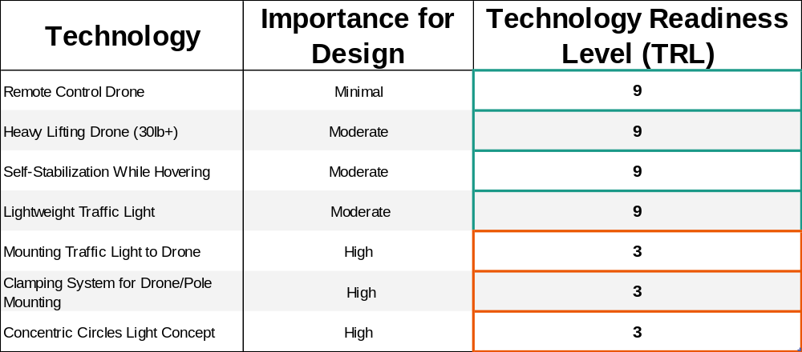
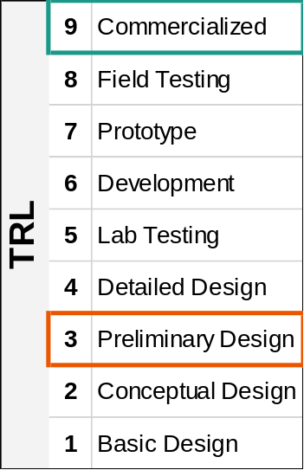
Technology Readiness Evaluation
Engineering
Specifications
Design Synthesis
Manufacturing/ Testing/Safety
Conclusions
Introduction
Speaker: Harley Nguyen

Slide 26
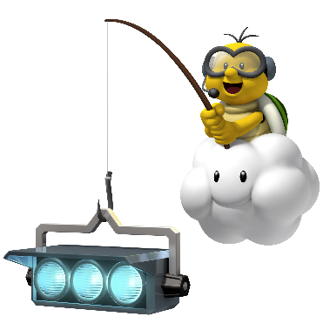



Anticipated Challenges
Engineering
Specifications
Design Synthesis
Manufacturing/ Testing/Safety
Conclusions
Introduction
FAA Regulations
Technology
Vandalism
Weather
http://www.learnuasag.org/2016/07/07/a-summary-of-faa-part-107-rules-by-the-uas-in-agriculture-learning-network/
https://gbatemp.net/threads/mario-kart-8-switch.455393
https://tattly.com/products/low-battery
http://www.ridewithharryd.com/ramblings/the-measurement-of-riding-achievement
Speaker: Harley Nguyen
Notes:
Because this is new, it is hard to tell what type of problems may arise thourhgout the use of the drone

Slide 27
Conclusions
Engineering
Specifications
Design Synthesis
Manufacturing/ Testing/Safety
Conclusions
Introduction
Design is new and unique
Meets customer requirements and specifications
Expands use/capabilities of traffic drone
Strongly encourage approval for prototype
Speaker: Harley Nguyen

Slide 28
Questions?

Slide 29
Works Cited
2012 National Traffic Signal Report Card Technical Report. US Department of Transportation Federal Highway Administration , 2012, 2012 National Traffic Signal Report Card Technical Report, library.ite.org/pub/e265477a-2354-d714-5147-870dfac0e294.
“Aircraft.” VulcanUAV, Harrier Industrial, 2016, vulcanuav.com/aircraft/.
“Freefly ALTA 8 Specifications - Dimensions, Weight & Payload.” Freefly Systems, freeflysystems.com/alta-8/specs.
“Knowledge Resources.” RITA | ITS | Costs: From The National Traffic Signal Report Card: Costs to Update Signal Timing Is $3,000 per Intersection., www.itscosts.its.dot.gov/its/benecost.nsf/0/215F723DB93D293C8525725F00786FD8.
“Traffic Signals.” Washington State Department of Transportation, 25 Aug. 2016, wsdot.wa.gov/Operations/Traffic/signals.htm.
U., Frank, et al. “XFold Dragon.” XFold Dragon x12 RTF U11 Drone, 12 Propellers, U11 Motor - for Heavy Winds XF-DR-X12U11-RTF, 8 Oct. 2017, www.adorama.com/xfdrx12u11rf.html.

Slide 30
Appendix

Slide 31
FAA Guidelines
• Unmanned aircraft must weigh less than 55 lbs. (25 kg).
• Visual line-of-sight (VLOS) only; the unmanned aircraft must remain within VLOS of the remote pilot in command and the person manipulating the flight controls of the small UAS. Alternatively, the unmanned aircraft must remain within VLOS of the visual observer.
• At all times the small unmanned aircraft must remain close enough to the remote pilot in command and the person manipulating the flight controls of the small UAS for those people to be capable of seeing the aircraft with vision unaided by any device other than corrective lenses.
• Small unmanned aircraft may not operate over any persons not directly participating in the operation, not under a covered structure, and not inside a covered stationary vehicle.
• Daylight-only operations, or civil twilight (30 minutes before official sunrise to 30 minutes after official sunset, local time) with appropriate anti-collision lighting.

Slide 32
FAA Guidelines
• Must yield right of way to other aircraft.
• May use visual observer (VO) but not required.
• First-person view camera cannot satisfy “see-and-avoid” requirement but can be used as long as requirement is satisfied in other ways.
• Maximum groundspeed of 100 mph (87 knots).
• Maximum altitude of 400 feet above ground level (AGL) or, if higher than 400 feet AGL, remain within 400 feet of a structure.
• Minimum weather visibility of 3 miles from control station.
• Operations in Class B, C, D and E airspace are allowed with the required ATC permission.
• Operations in Class G airspace are allowed without ATC permission.
• No person may act as a remote pilot in command or VO for more than one unmanned aircraft operation at one time.
• No operations from a moving aircraft.

Slide 33
FAA Guidelines
No operations from a moving vehicle unless the operation is over a sparsely populated area.
• No careless or reckless operations.
• No carriage of hazardous materials.
• Requires preflight inspection by the remote pilot in command.
• A person may not operate a small unmanned aircraft if he or she knows or has reason to know of any physical or mental condition that would interfere with the safe operation of a small UAS.
• Foreign-registered small unmanned aircraft are allowed to operate under part 107 if they satisfy the requirements of part 375.
• External load operations are allowed if the object being carried by the unmanned aircraft is securely attached and does not adversely affect the flight characteristics or controllability of the aircraft.
• Transportation of property for compensation or hire allowed provided that the aircraft, including its attached systems, payload and cargo weigh less than 55 pounds total;

Slide 34
FAA Guidelines
The flight is conducted within visual line of sight and not from a moving vehicle or aircraft; and
The flight occurs wholly within the bounds of a State and does not involve transport between (1) Hawaii and another place in Hawaii through airspace outside Hawaii; (2) the District of Columbia and another place in the District of Columbia; or (3) a territory or possession of the United States and another place in the same territory or possession.
• Most of the restrictions discussed above are waivable if the applicant demonstrates that his or her operation can safely be conducted under the terms of a certificate of waiver.

