Slide 1


LCDC 2019

Slide 2
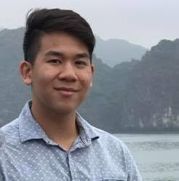
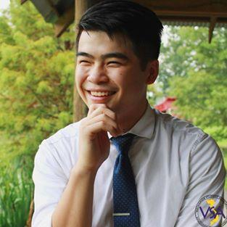
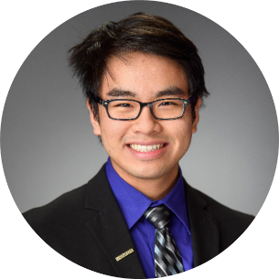
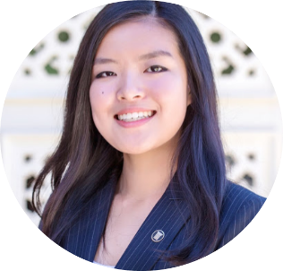
Meet the Chairs
Peter Pham - Mechanical Engineering (Jr.)
Lucy Guo - Mechanical Engineering (Jr.)
Phillip Huynh - Electrical Engineering (Jr.)
Michael Hom - Electrical Engineering (Jr.)
Peter Pham
LCDC Head Chair
Lucy Guo
LCDC Design Chair
Phillip Huynh
Co-Logistics Chair
Michael Hom
Co-Logistics Chair

Slide 3
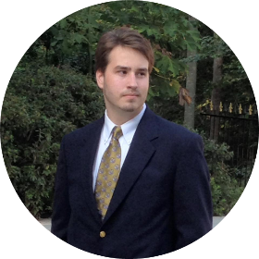
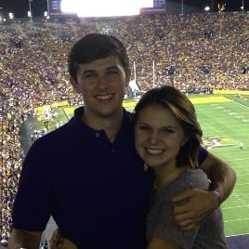

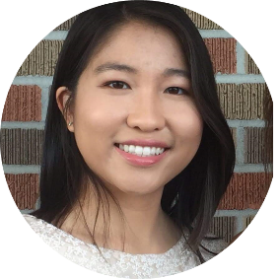
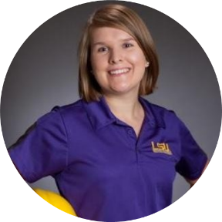
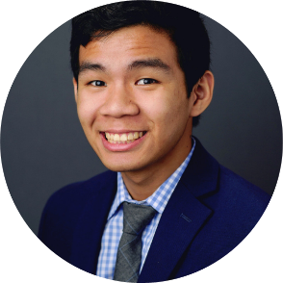
Meet the Chairs
Burke Bollinger – Mechanical Engineering (Soph.)
Nick Boudreaux – Mechanical Engineering (Jr.)
Joshua Nguyen - Mechanical Engineering (Super Senior)
Grace Nguyen - Biological Engineering (Soph.)
Peter Nguyen - Electrical Engineering (Jr.)
Lindy Shea – Industrial Engineering (Sr.)
Burke Bollinger
Co-Competition Chair
Nick Boudreaux
Co-Competition Chair
Joshua Nguyen
Funding Chair
Grace Nguyen
Co-Program Chair
Lindy Shea
Co-Program Chair
Peter Nguyen
Historian

Slide 4
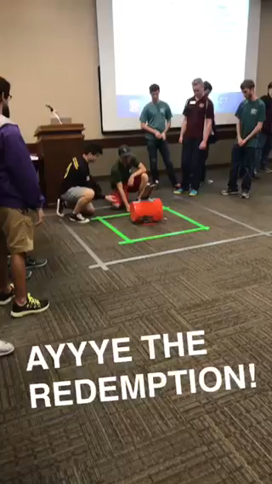
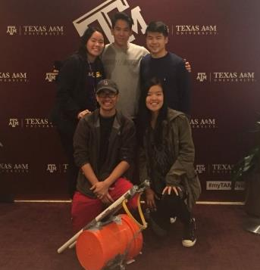
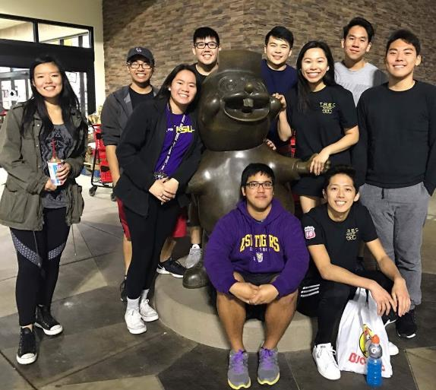
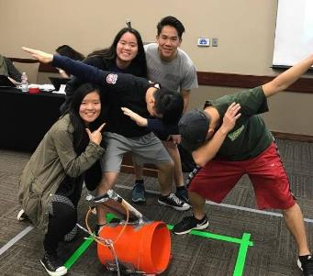
TREC 2017
Notes:
The first year we went to Texas A&M as freshmen and were able to visit and stop by Houston to get food. It was a good experience and it was then that we wanted to bring an event back to LSU.

Slide 5
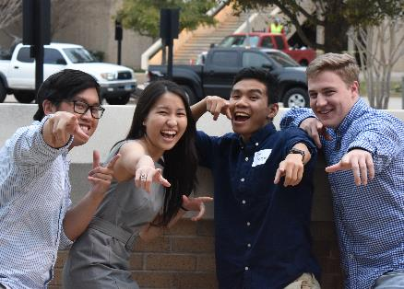
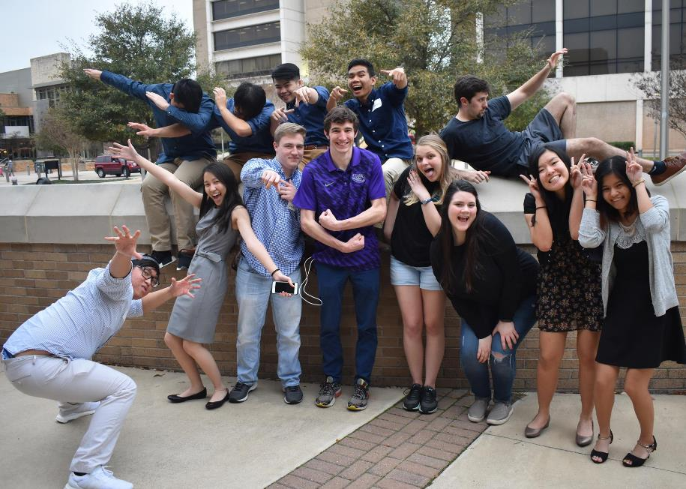
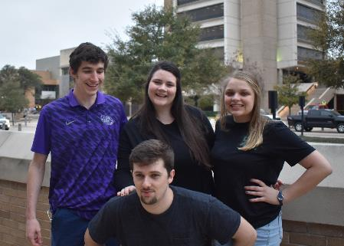
TREC 2018
Notes:
The first year we went to Texas A&M as freshmen and were able to visit and stop by Houston to get food. It was a good experience and it was then that we wanted to bring an event back to LSU.

Slide 6
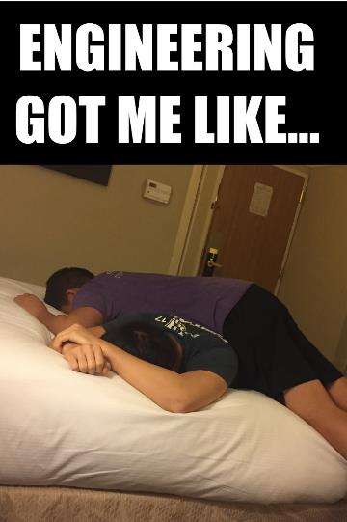
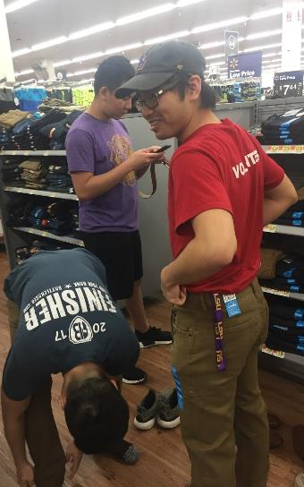
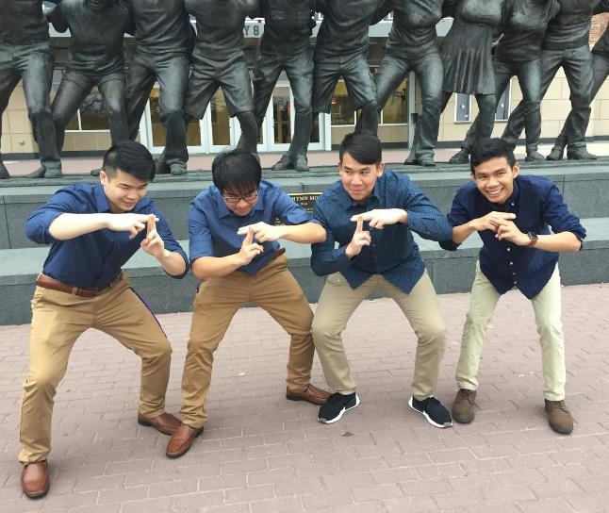
TREC 2018
Notes:
The first year we went to Texas A&M as freshmen and were able to visit and stop by Houston to get food. It was a good experience and it was then that we wanted to bring an event back to LSU.

Slide 7
TREC
LREC
LCDC
Notes:
Now here we are with good turn out of 27 teams

Slide 8
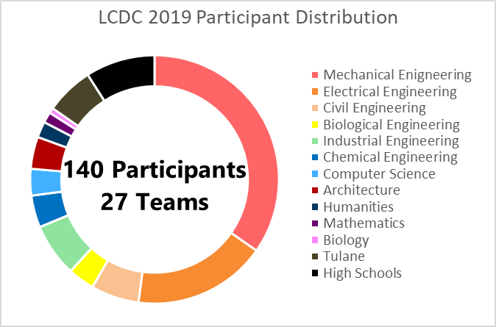
LCDC 2019
Notes:
Now here we are with good turn out of 27 teams

Slide 9


Our Sponsors
Notes:
Now here we are with good turn out of 27 teams

Slide 10
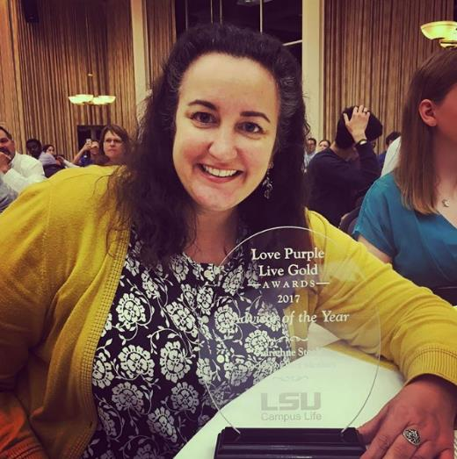
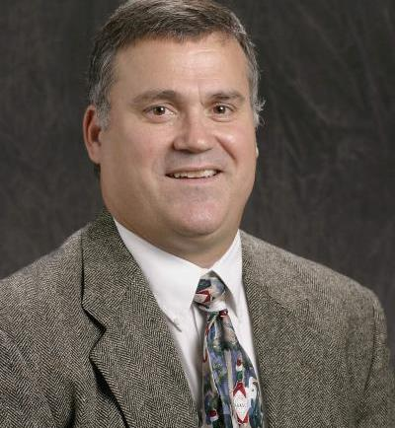
Thank you to Adrienne Steele and Dr. Wagg!
Notes:
Now here we are with good turn out of 27 teams

Slide 11










Goals of LCDC
Innovation
Leadership
Teamwork
Networking
Having fun
Teamwork
Innovation
Leadership
Networking
Have Fun!
Notes:
Planning this event has been a wild journey and we hope teach you all a little bit more about what it means to be part of a team working towards a common goals. We hope to see teams get creative and having fun. But also being able to learn a little bit more about networking and have practice talking to industry representatives.

Slide 12







Industry Representative Coming:

Slide 13
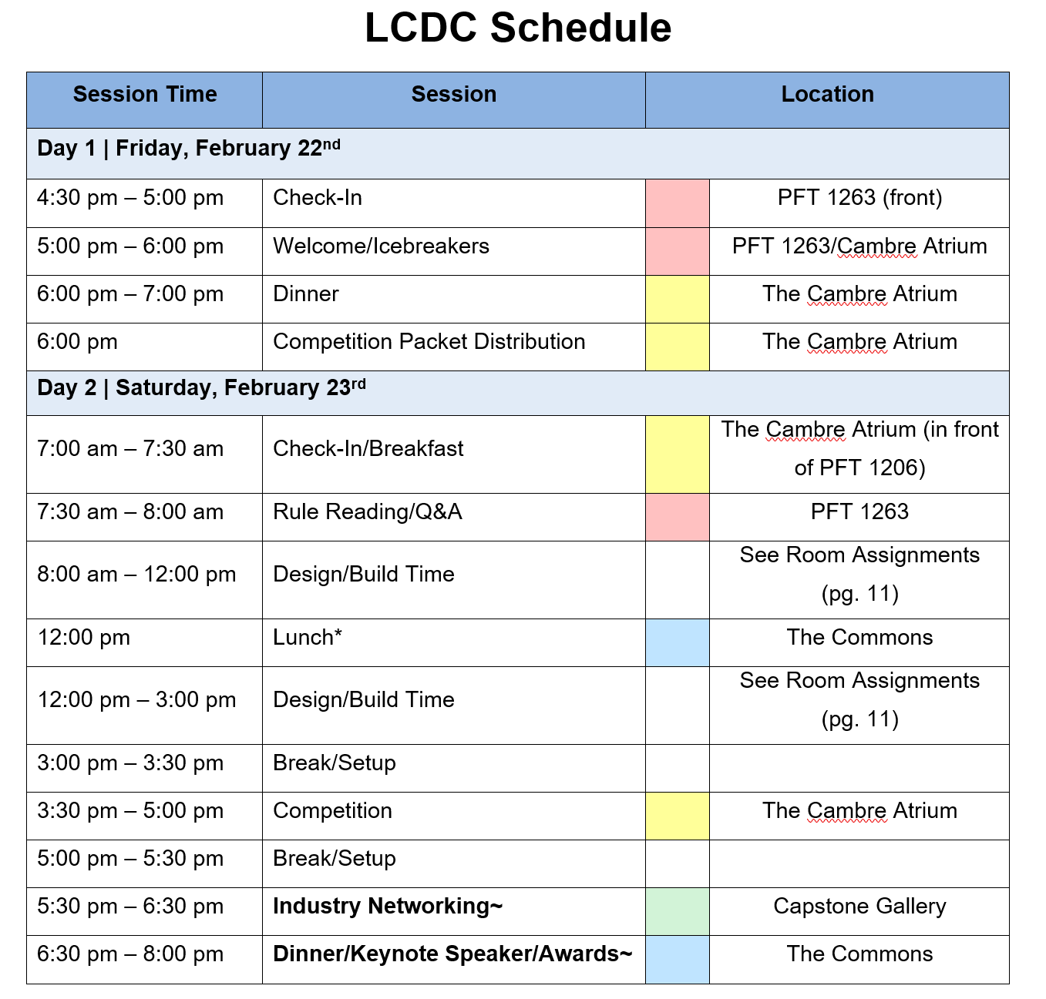

Slide 14
House Keeping:
If you need help: Look for someone wearing a LCDC Shirt today or Black SPM shirt tomorrow
Team Leaders: Join the GroupMe
Treat this building like you would treat a $114 million dollar car
Make your friends who didn’t come jealous:
Snapchat Filter
#Eweek2019

Slide 15
Questions:
Have until 7 A.M tomorrow to submit questions to Burke
  Game questions or material requests
lcdc.lsu@gmail.com
Will have a Q&A Session during breakfast Saturday for the competition

Slide 16
Questions?

