Slide 1

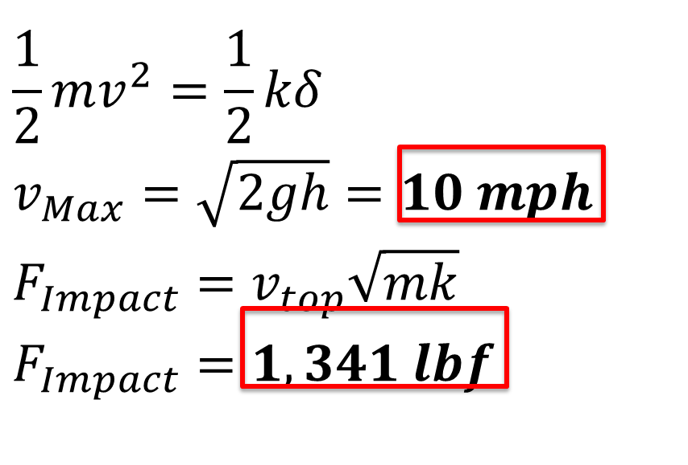






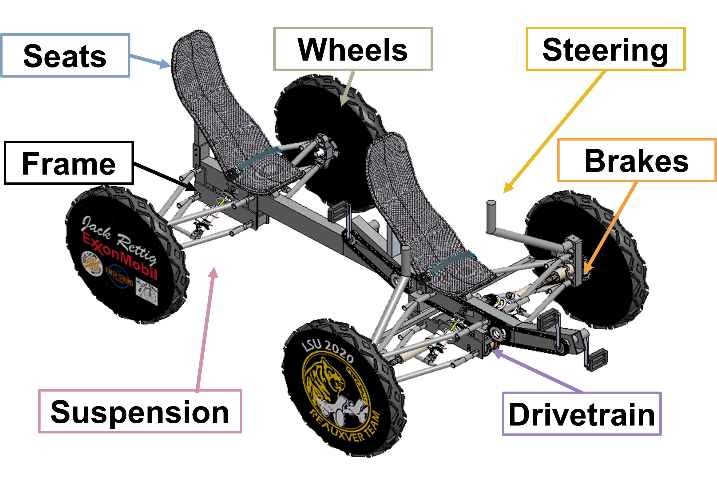
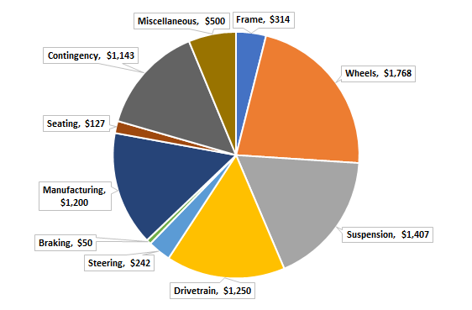
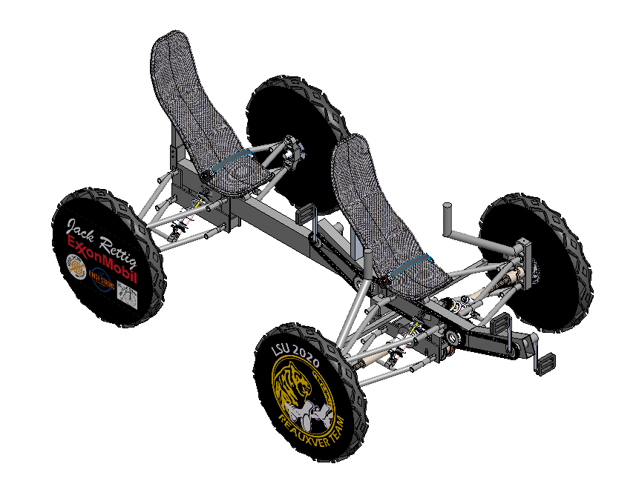
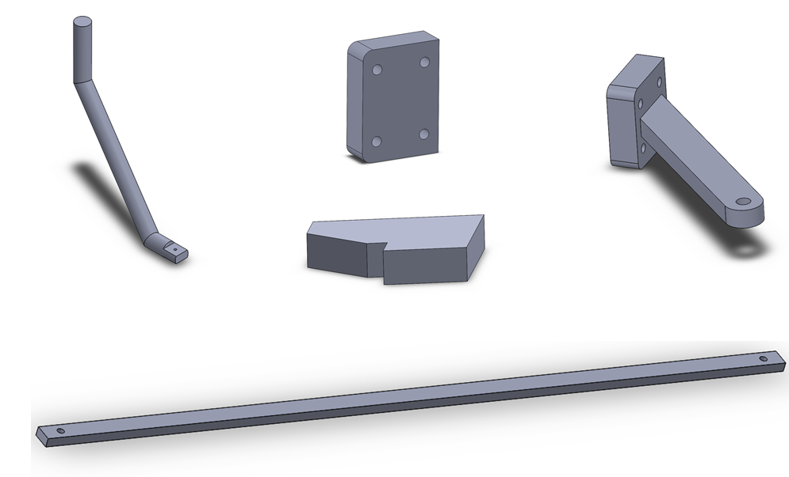
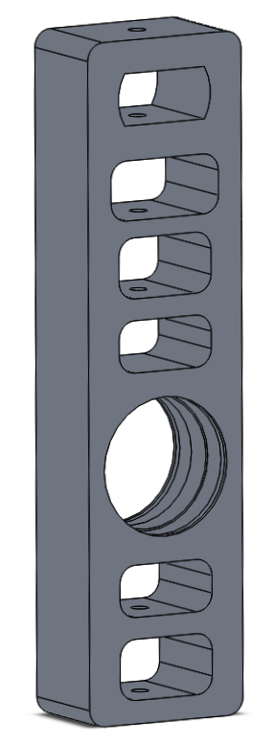
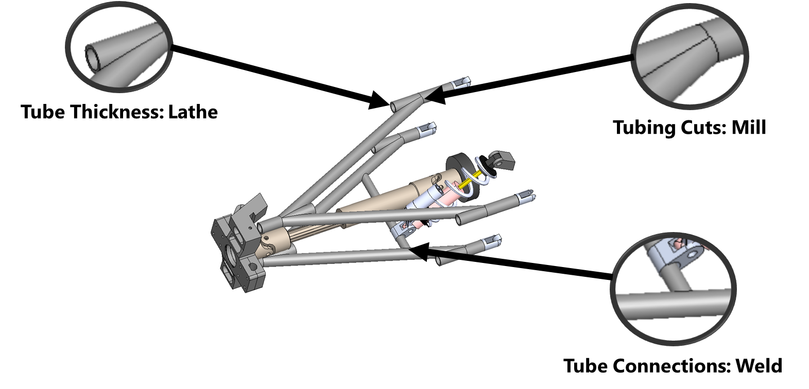
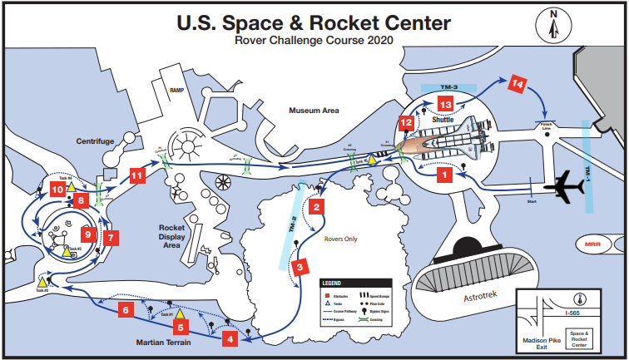
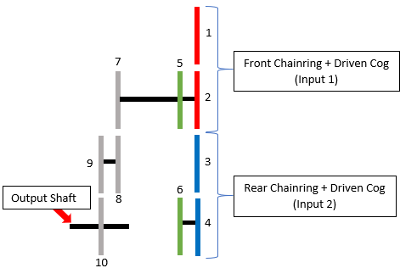
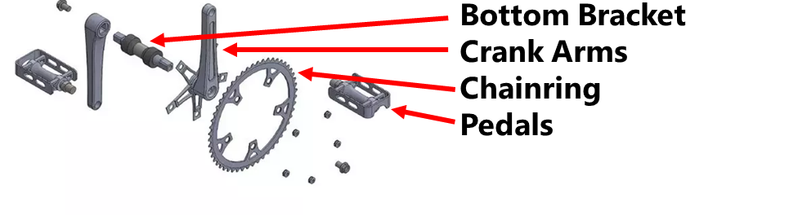
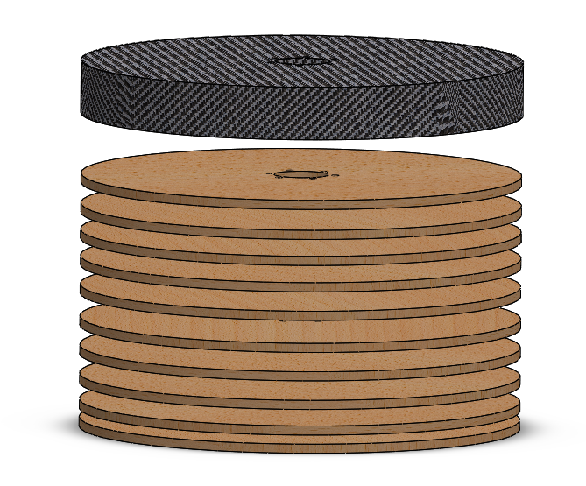
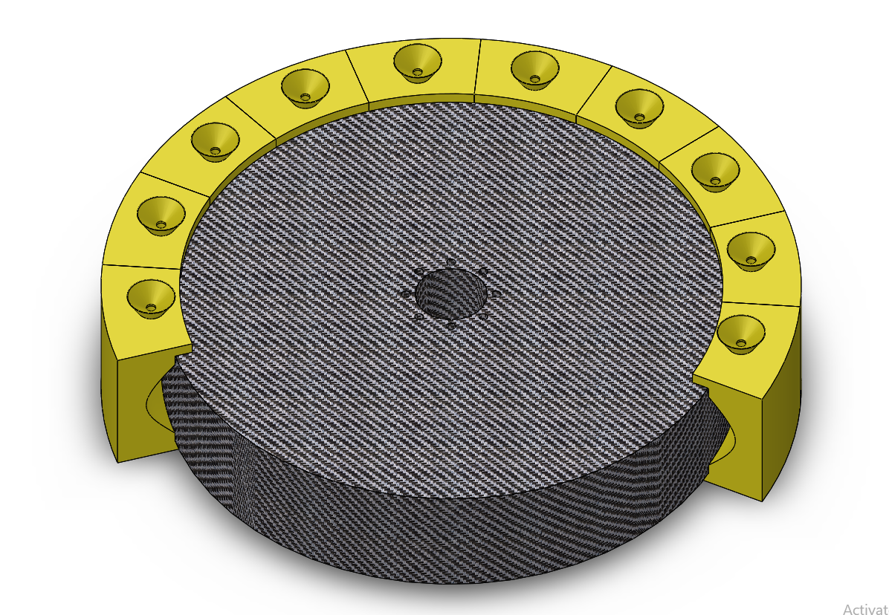
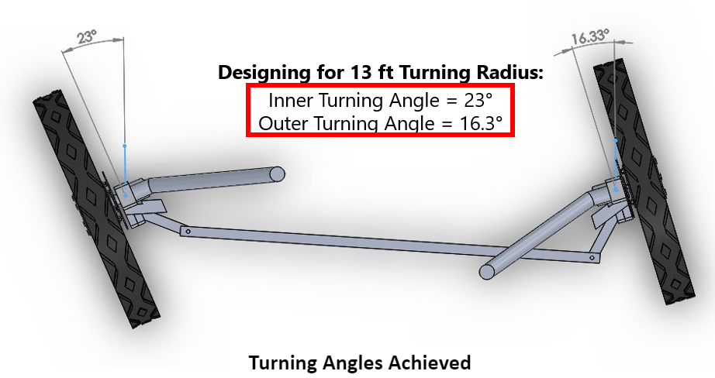

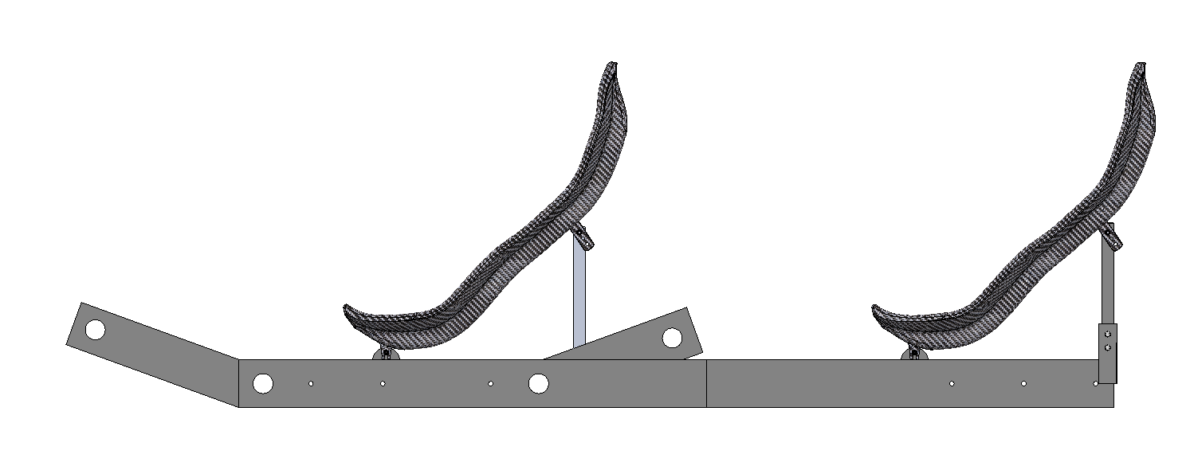
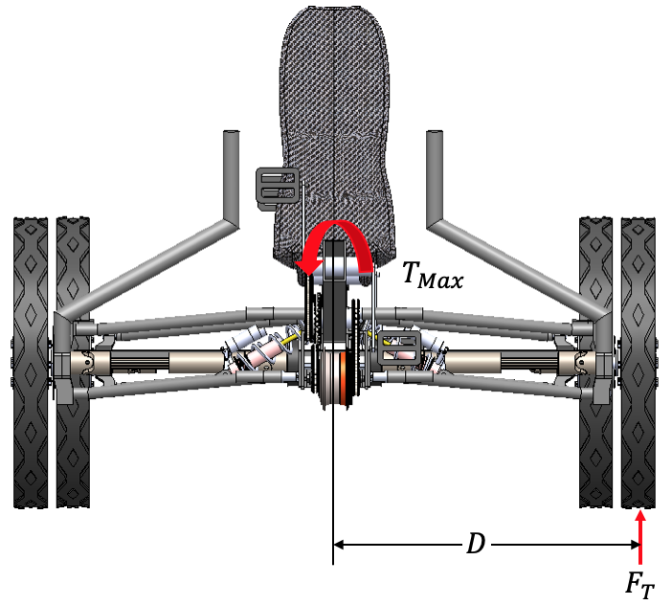

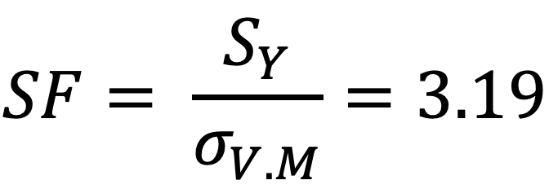
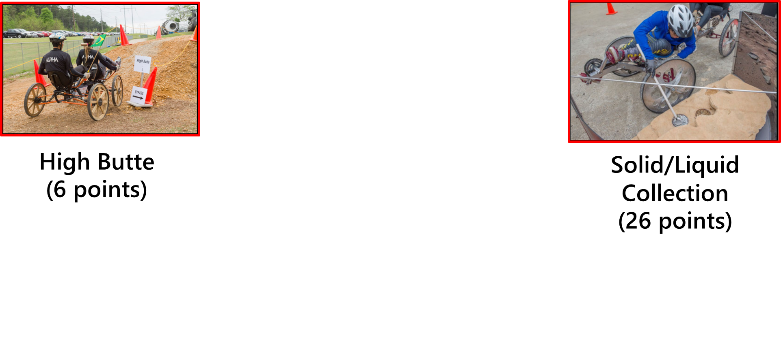
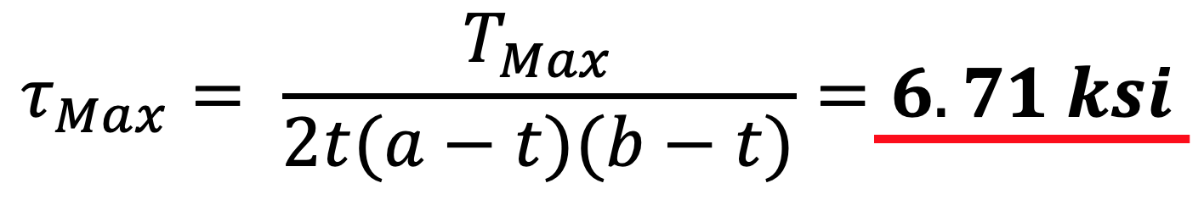
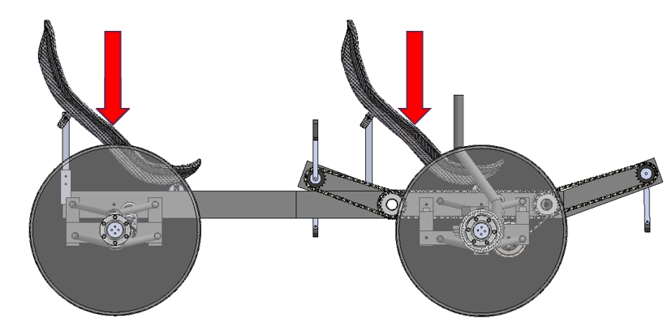
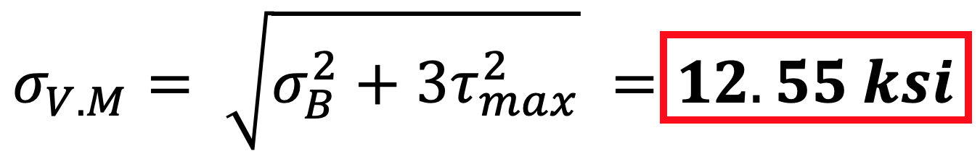
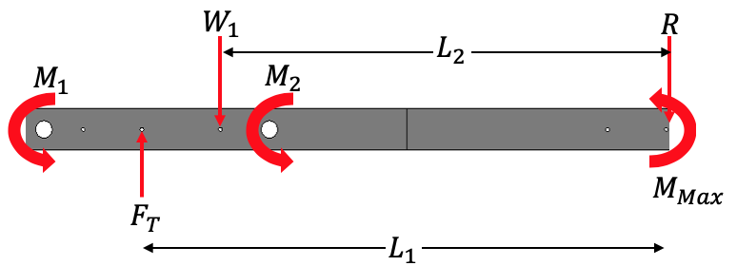

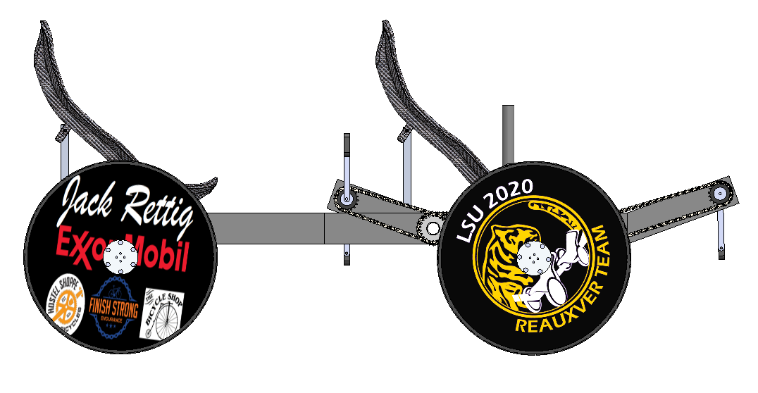
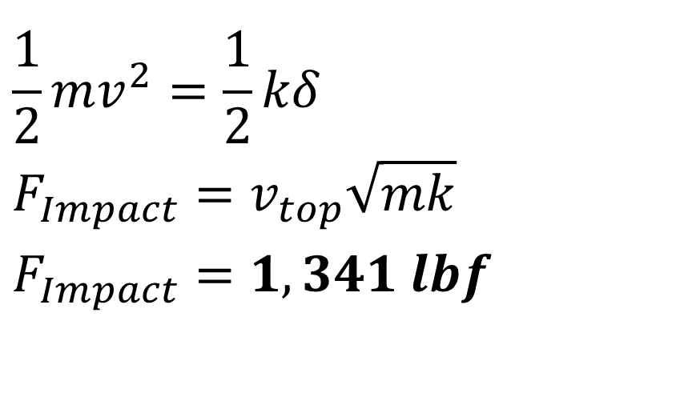
Team 24: NASA Human Exploration Rover Challenge
Matthew Donner (ME), Garrett Gremillion (ME), Lucy Guo (ME), Dakota Hebert (ME),
Peter Pham (ME), Evan Prejean (ME), Mike Smith (ME)
Objective Statement
Final Proposed Design
Budget
“To engineer a human-powered rover to win the 2020 NASA Rover Challenge by:
Improving the drivetrain
Manufacturing four new wheels
Reducing overall weight.”
2020 Team Final Budget, $8,000
Additional Funding Received:
ExxonMobil - $1,000
Travel (Paid by LSU MIE Dept):
Drive - $1,080
Lodging - $1,040
Sponsors:
Jack Rettig
Exxon Mobil
Dr. Nikitopoulos
Donations:
The Bicycle Shop
Hostel Shoppe Bicycles
Finish Strong Endurance
Seats
Wheels
Steering
Course Outline
Manufacturing Plan
April 17th-18th , Huntsville, AL
8 minutes: 14 Obstacles, 5 Tasks
Total possible points: 114
Steering
Suspension
Frame
Brakes
Wheels
Drivetrain
Steering
Drivetrain
Wheels
Seats and Frame
Engineering Specs.
Testing Plan
Suspension
Drivetrain
Specifications | Target
Clearance | c_{R} ≥ 1 ft*
Width | w_{R} ≤ 5 ft*
Average Speed | v_{R} ≥ 4 mph*
Turning Radius | R_{T} ≤ 15 ft*
Weight | W_{R} ≤ 130 lbs. (5 pts)
Collapsed Volume | V_{R} ≤ 125 ft³ (5x5x5) (4 pts)
Assembly Time | t_{A} ≤ 2 min. (2 pts)
Testing: 3/16/20-4/15/20
Recreate and Practice Course
Ensure All Design Requirements are met
Frame
Suspension
$$\frac{1}{2}mv^{2}=\frac{1}{2}kδ$$
$$F_{Impact}=v_{top}\sqrt{mk}$$
$$F_{Impact}=1,341 lbf$$
*Not meeting specifications will result in disqualification
Adviser: Dr. W. Waggenspack
Sponsors: Jack Rettig, ExxonMobil
Concept Generation
Sep 17-Oct 1
Concept Selection
Oct 2-Oct 29
Engineering Analysis
Oct 30-Dec 1
Purchasing
Dec 1-Dec 11
Manufacturing
Dec 15-Mar 14
Testing
Mar 15-Apr 16
Competition
Apr 17-18

