Slide 1
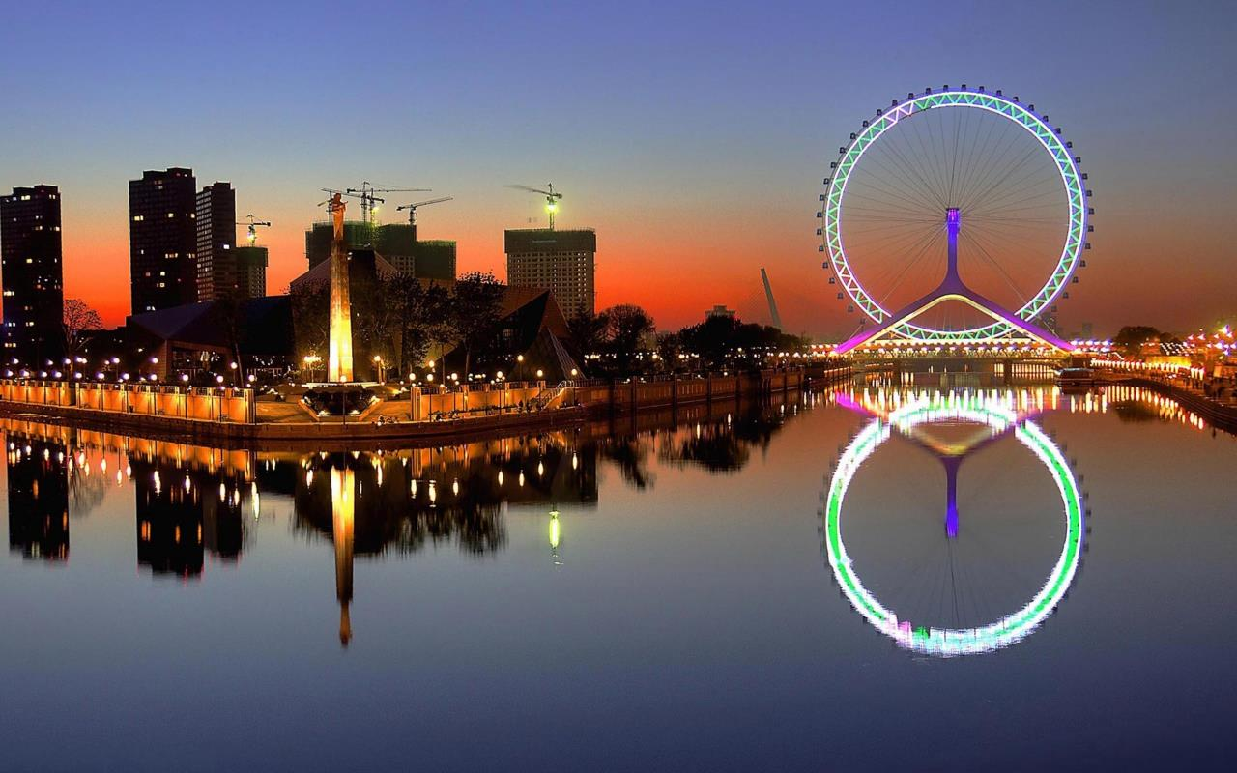
TIANJIN
Summer Experience
Lucy Guo

Slide 2
Overview
Background Research
Grasshopper/Rhino/Kangaroo
Misc.
Week 1
Week 2
Week 3
Metal Based Miura-Ori Manufacturing
Designs
Weekends

Slide 3
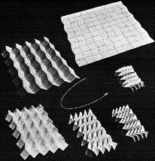
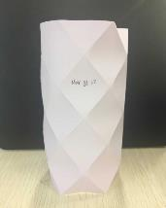
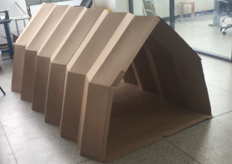

Background
GrasshopperRhino
Kangaroo
Metal Based Miura-Ori
Deployable Tent Designs
Misc.
Motion Structures Laboratory Research:
Origami inspired Thin-Walled Metal Structures
Reconfigurable mechanisms: Geometrical transformation of truncated tetrahedron to tetrahedron linkage design
Experimental modifications of Miura-Ori Design
Metal-Based Miura-Ori compression design
3D printed deployable rubber cubes
Strengthening metamaterial through origami inspired structures
Buckling of paper tiled tubes
Rigid Origami Deployable Tent
Day 1: May 31, 2017

Slide 4
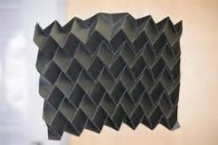
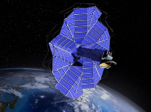
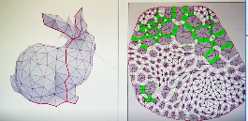
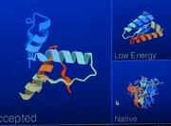
Background
GrasshopperRhino
Kangaroo
Metal Based Miura-Ori
Deployable Tent Designs
Misc.
Current applications of Origami-inspired devices:
Shape-shifting satellite radiator/ solar panels
Gel used to create self-folding models on an extremely small scale—can control angle of fold from amount of gel exposed to water
Origami with Graphene (thinnest material in existence—about 1 atom thick) to create self-folding machines.
Use of Shape Metal Alloys (SMA) in self-folding origami applications
Polymer structural identification inspired by origami
Computer program which can convert any 3D model into a 2D Crease pattern
Polymer Gel
Surface Plate
Day 2-3: Jun 1-2, 2017

Slide 5
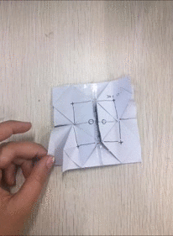
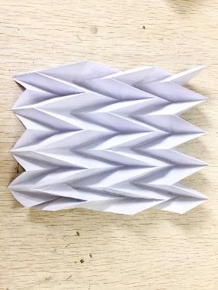
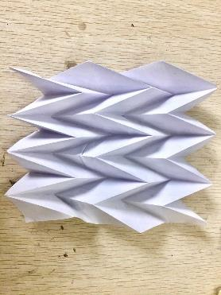
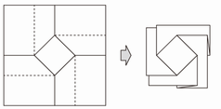
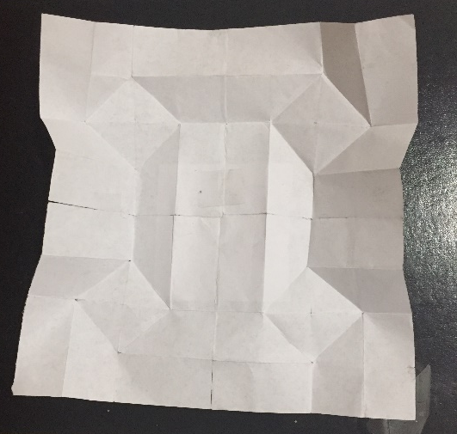
Background
GrasshopperRhino
Kangaroo
Metal Based Miura-Ori
Deployable Tent Designs
Misc.
Miura-ori Fold
Twist Fold
First Attempt
Second Attempt
Day 2-3: Jun 1-2, 2017

Slide 6
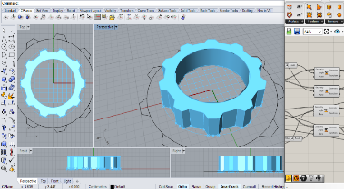

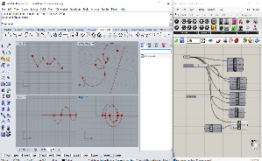
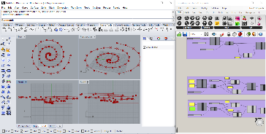
Background
Grasshopper
Rhino
Kangaroo
Metal Based Miura-Ori
Deployable Tent Designs
Misc.
Days spent/ Topics learned
Main topics covered: Sequences, spirals, editable remote control framework , attractors, conditional statements, curves, vectors, basic math, grids, plane and line geometry, parameterization constants.
Prepared and presented previous research conducted on Additive Manufacturing
Familiarizing with software: Grasshopper
Day 4-6: Jun 5-7, 2017

Slide 7
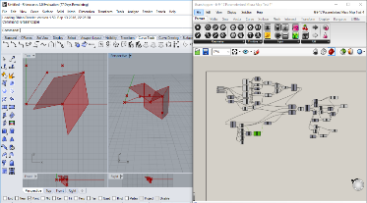
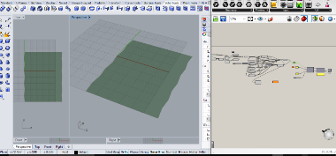
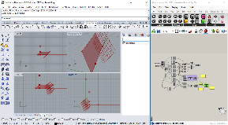
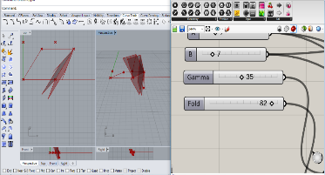
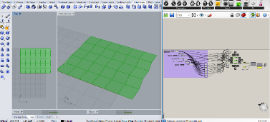
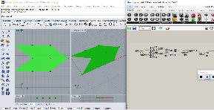
Rhino
Background
Grasshopper
Rhino
Kangaroo
Metal Based Miura-Ori
Deployable Tent Designs
Misc.
Modeling of Miura-Ori: Rhino and Grasshopper
Miura-Ori: Full Sheet
Miura-Ori: Single group (parameterized)
Test 1
Test 2
Miura-Ori Attempt 4 (Issues with connection when folding)
Day 7-8 : Jun 8-9, 2017

Slide 8
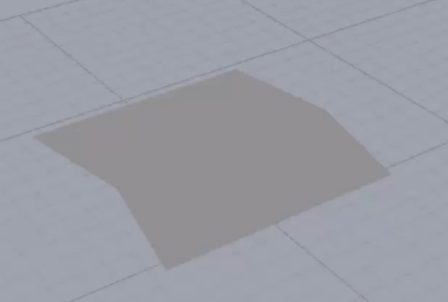
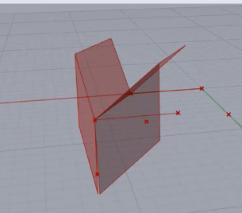
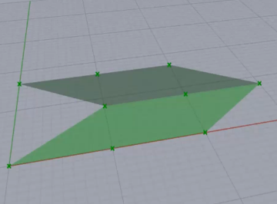
Background
Grasshopper
Rhino
Kangaroo
Metal Based Miura-Ori
Deployable Tent Designs
Misc.
Miura-ori Folding Simulations: Kangaroo
Miura-Ori Simulations: Attempts 1 and 2, Errors in vertex connections while folding
Miura-Ori Simulations: Successful folding
Day 8: Jun 9, 2017

Slide 9
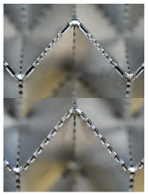
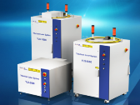
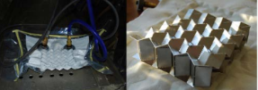
Background
Grasshopper
Rhino
Kangaroo
Metal Based Miura-Ori
Deployable Tent Designs
Misc.
Introduce laser, background on aluminum
Novel manufacturing method for Metal Based Miura-ori compression design:
Objective: use IPG Photonics High-powered laser system to laser cut and welding to fabricate thick-paneled Miura-ori compression design.
Increase thickness of current Miura-ori design
Improve the variability of metal materials that can be used to fabricate compression models.
Design inspiration from Previous research:
Aluminum thin-sheet folding using cold gas pressure
perforation pattern
Reduce systemic error and labor intensity of manufacturing process
M. Schenk, J., M. Allwood, S. D. Guest, (2015), “Cold Gas Pressure Folding of Miura-ori Sheets”, Cambridge.
Day 9-11: Jun 12-14, 2017

Slide 10
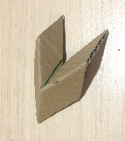
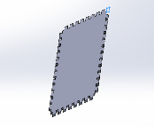
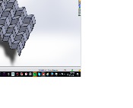
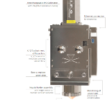
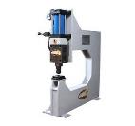
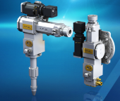
Background
Grasshopper
Rhino
Kangaroo
Metal Based Miura-Ori
Deployable Tent Designs
Misc.
Metal based Miura-ori compression piece workflow:
Laser-Cut material
Compress metal to fold
Paper/ Cardboard Model: single unit
Design in Solidworks
Assemble in Solidworks
Weld weakened joints
Day 9-11: Jun 12-14, 2017

Slide 11
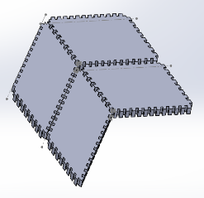
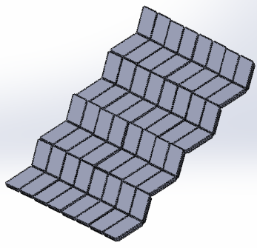
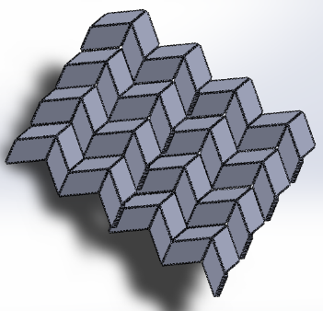
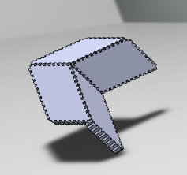
Background
Grasshopper
Rhino
Kangaroo
Metal Based Miura-Ori
Deployable Tent Designs
Misc.
Metal based Miura-ori flat and folded designs:
Folded Layout
Flat Layout
Day 9-11: Jun 12-14, 2017

Slide 12
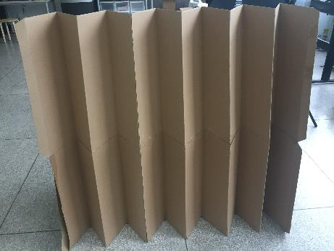
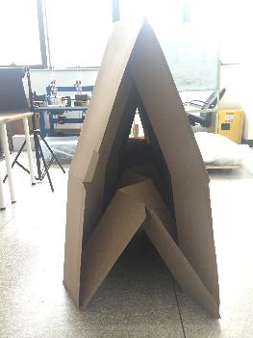
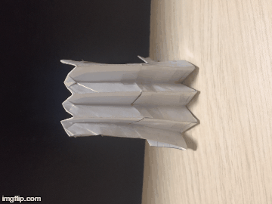
Background
Grasshopper
Rhino
Kangaroo
Metal Based Miura-Ori
Deployable Tent Designs
Misc.
Deployable Tent Design:
Day 12-13: Jun 15-16, 2017

Slide 13
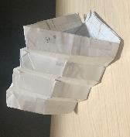
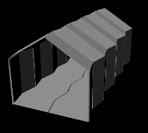
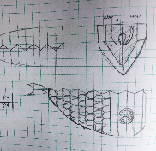
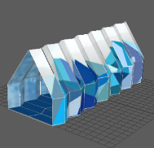
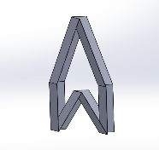
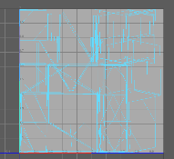
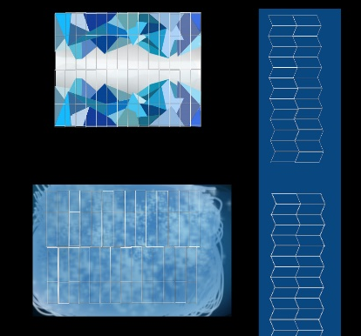
Background
Grasshopper
Rhino
Kangaroo
Metal Based Miura-Ori
Deployable Tent Designs
Misc.
Deployable Tent Design Methodology:
Maya
Paper Model
Sketch Design
Maya render
UV
Solidworks
Photoshop
Day 12-13: Jun 15-16, 2017

Slide 14
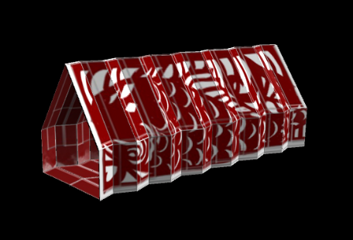
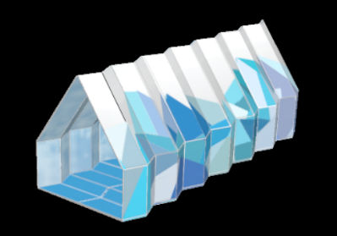

Designs
Background
Grasshopper
Rhino
Kangaroo
Metal Based Miura-Ori
Deployable Tent Designs
Misc.
Show various designs
Deployable Tent Designs:
Asian-inspired paper cutout fish tent
Multi-Colored Geo Tent
Simple Black and White
Day 12-13: Jun 15-16, 2017

Slide 15



Designs
Background
Grasshopper
Rhino
Kangaroo
Metal Based Miura-Ori
Deployable Tent Designs
Misc.
Deployable Tent Variations:
Fish Design:
Variations in height and width
Day 12-13: Jun 15-16, 2017

Slide 16




Designs
Background
Grasshopper
Rhino
Kangaroo
Metal Based Miura-Ori
Deployable Tent Designs
Misc.
Deployable Tent Variations (Cont.):
Bottom half of Single Unit
Paper Model
Floor Design Sketch
Solidworks Floor Model
Day 1: May 31, 2017

Slide 17










Misc.
Background
Grasshopper
Rhino
Kangaroo
Metal Based Miura-Ori
Deployable Tent Designs
Misc.
Adventures in Tianjin/Beijing: fun/food
Weekend adventures:

Slide 18
Reflection and Future plans
Complete Miura-Ori compression model and fabricate a prototype
Continue refining variable length tent design and construct real model
Create origami-inspired video game

Slide 19
Thank You!
Questions?

